Slide 1
Bank Marketing Campaign Analysis
Tableau Dashboard Presentation by
Wafa shakkir

Slide 2
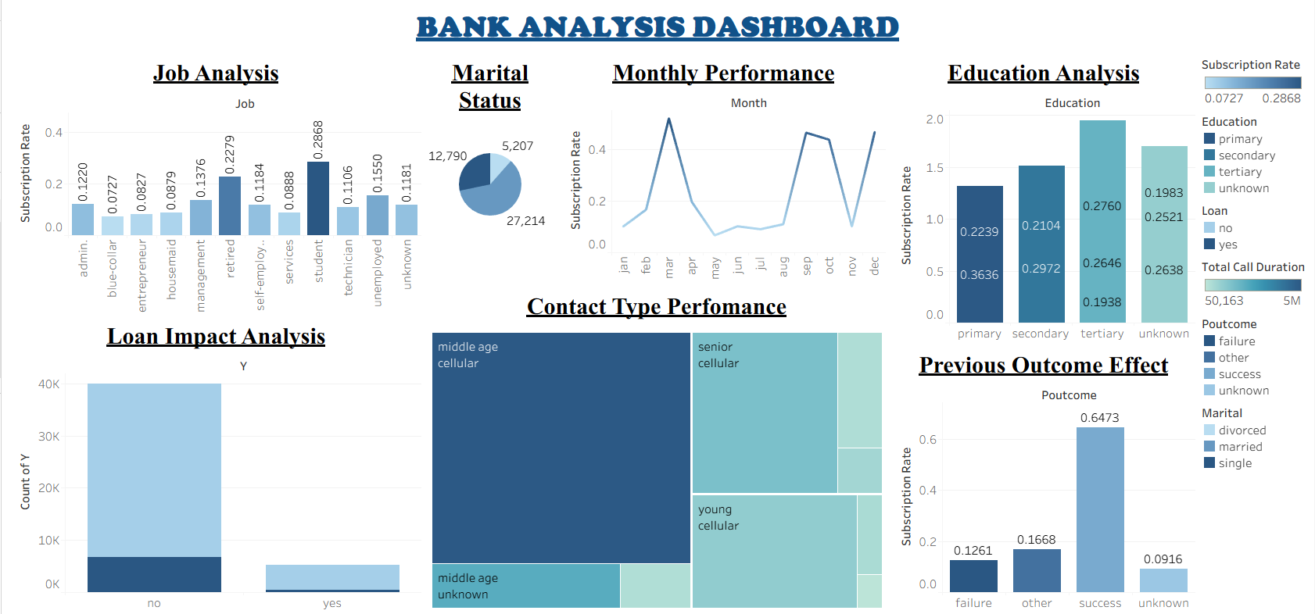

Slide 3
Dataset Overview
The dataset is based on a bank marketing campaign.
It contains customer demographic and campaign-related information .
Key Attributes : job, marital, education, loan, contact, month, poutcome, y.
Target Variable (y): Indicates whether the customer subscribed (yes/no).
Total records represent individual customer campaign interactions.

Slide 4
Project objectives
Analyze customer demographics affecting subscription .
Identify key factors influencing term deposit subscription .
Evaluate campaign performance across months and contact types .
Measure impact of previous campaign outcomes .
Provide data-driven insights to improve marketing strategy .

Slide 5
Job Analysis
Compares subscription rate across job categories .
Students and retired customers show higher subscription rates .
Identifies high-potential target segments .

Slide 6
Marital Status
Displays percentage distribution of customers .
Majority of customers are married .
Helps in demographic segmentation .

Slide 7
Monthly Performance
Shows subscription rate trend by month .
Identifies peak-performing months .
Highlights seasonal campaign effectiveness

Slide 8
Education Analysis
Compares education levels and subscription behavior .
Tertiary education group shows strong performance .
Supports education-based targeting .

Slide 9
Loan Impact Analysis
Compares subscriptions behavior based on loan status .
Financial commitments influence subscription decisions .

Slide 10
Contact Type Performance
Analyzes performance of contact methods .
Cellular contact shows better engagement .
Optimizes communication strategy .

Slide 11
Previous Outcome Effect
Bar chart showing subscription rate by previous campaign result.
Previous success significantly increases subscription probability .
Failure and unknown outcomes show lower conversion rates.
Important predictor for future campaign planning .

Slide 12
Conclusion
This dashboard provides a comprehensive analysis of banking customer and loan data. It helps stakeholders understand customer distribution, loan status, approval trends and overall business performance through interactive visualizations.

Slide 13
THANK YOU

